Slide 1
CSE 465 Lecture 5 & 6
CNN – Convolutional Neural Network

Slide 2
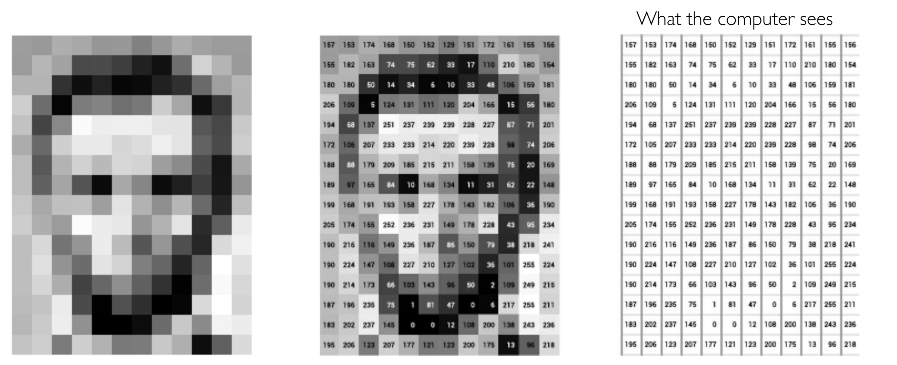
Images/videos are just matrix with numbers

Slide 3
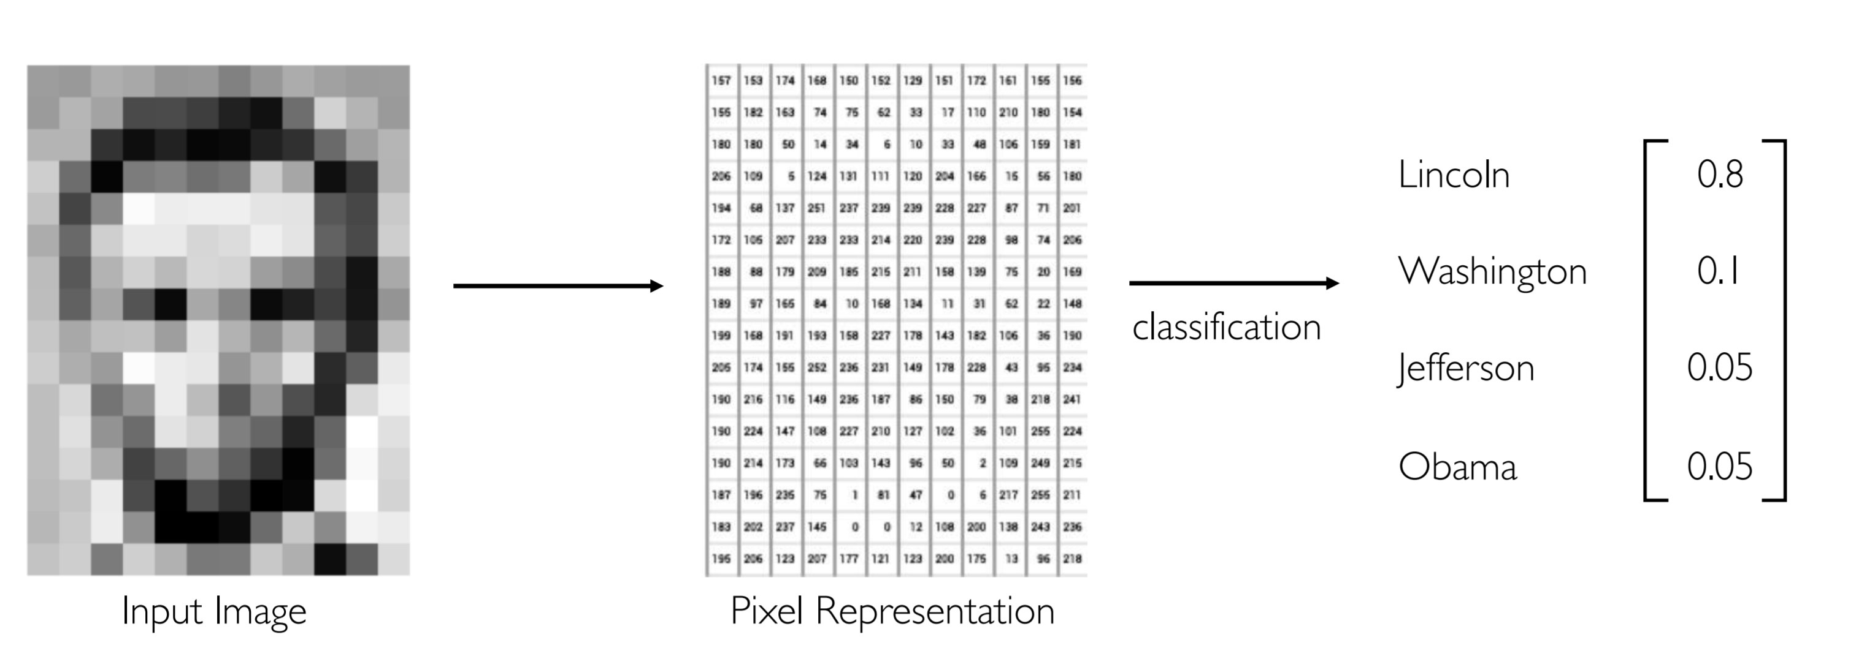
What do we want to do?

Slide 4
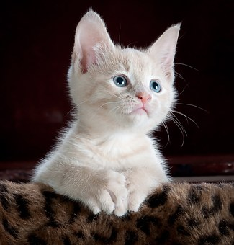
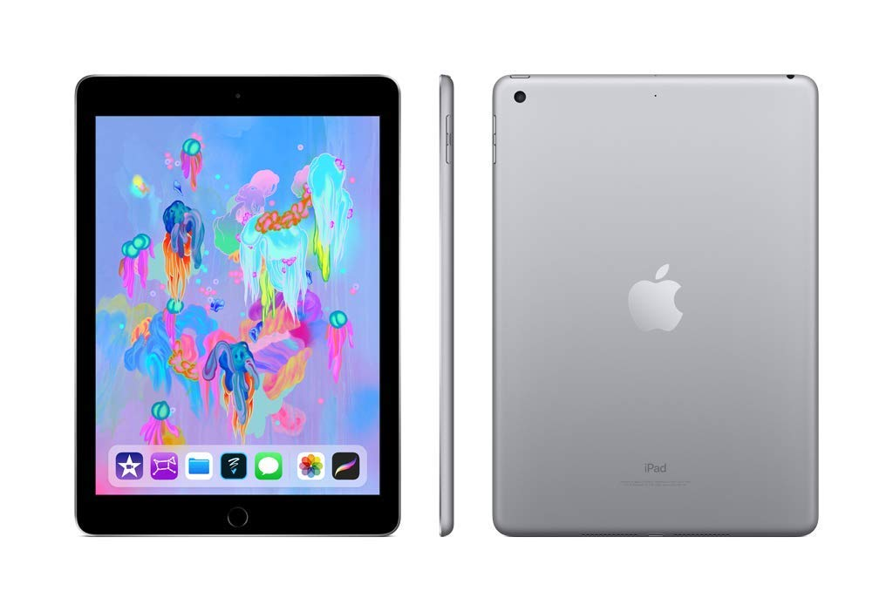
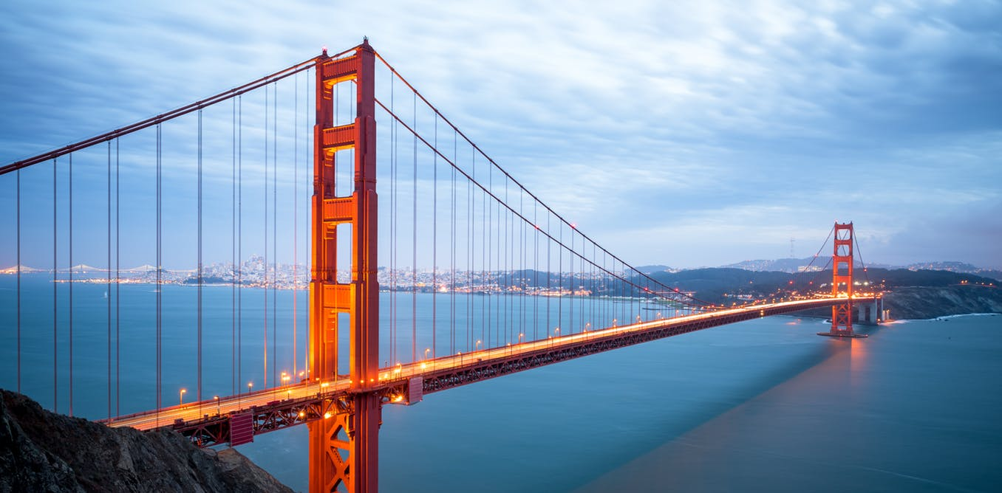
How to categorize images?
Use features
Rectangular shape
Has bevels
There is a logo of apple
Long thick lines
Hanging ropes
Structure hanging over poles
Has nose
Has long ears
Has eyes
White color

Slide 5
Manual feature detection
Must have domain knowledge
Have previous experiences with best practices
Define features
Define previously known features
Generate new features
Use the features to classify
The classifier will use the features

Slide 6
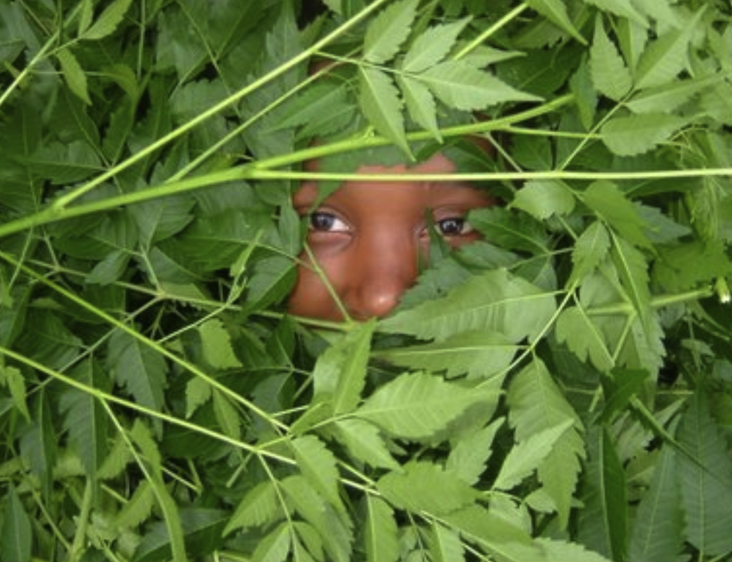
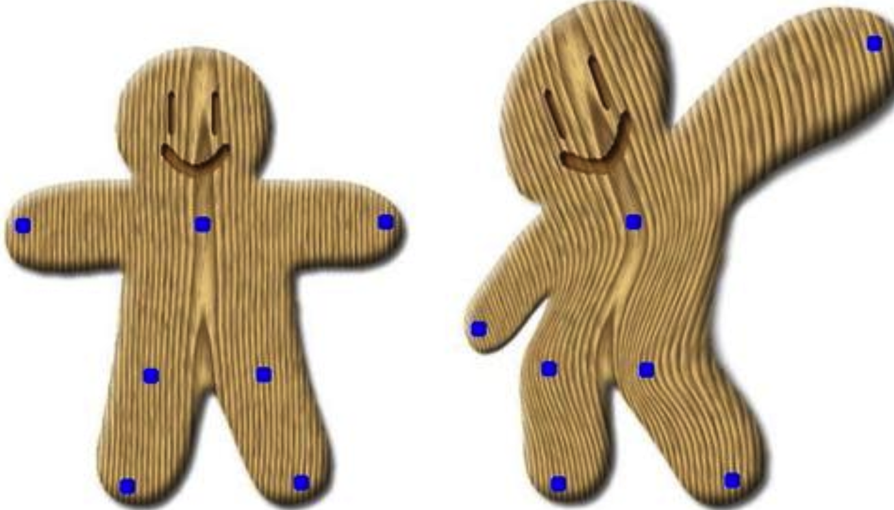
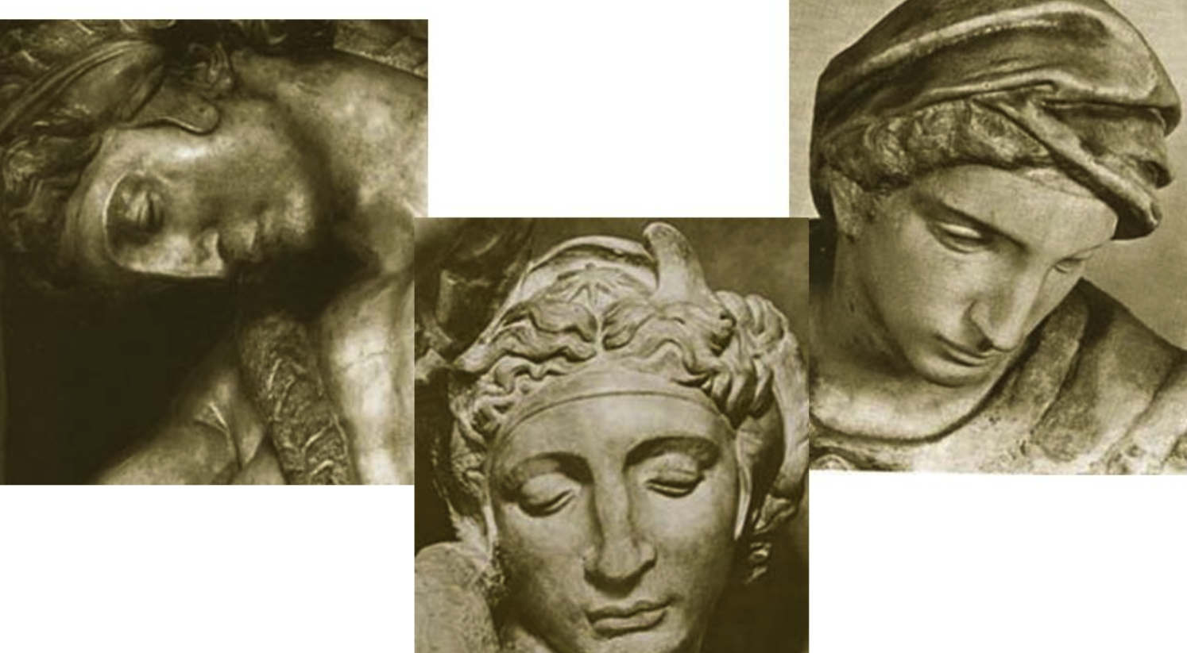
Manual feature detection: Problems
Occlusion
Blocking partially
Different illumination
Amount of light/brightness change
Scale variation/deformation
Viewpoint variation

Slide 7
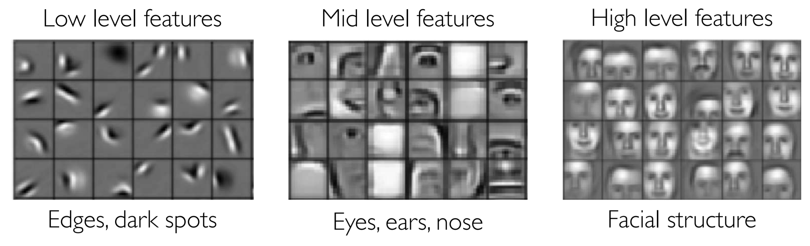
How can we use machine to learn features?

Slide 8
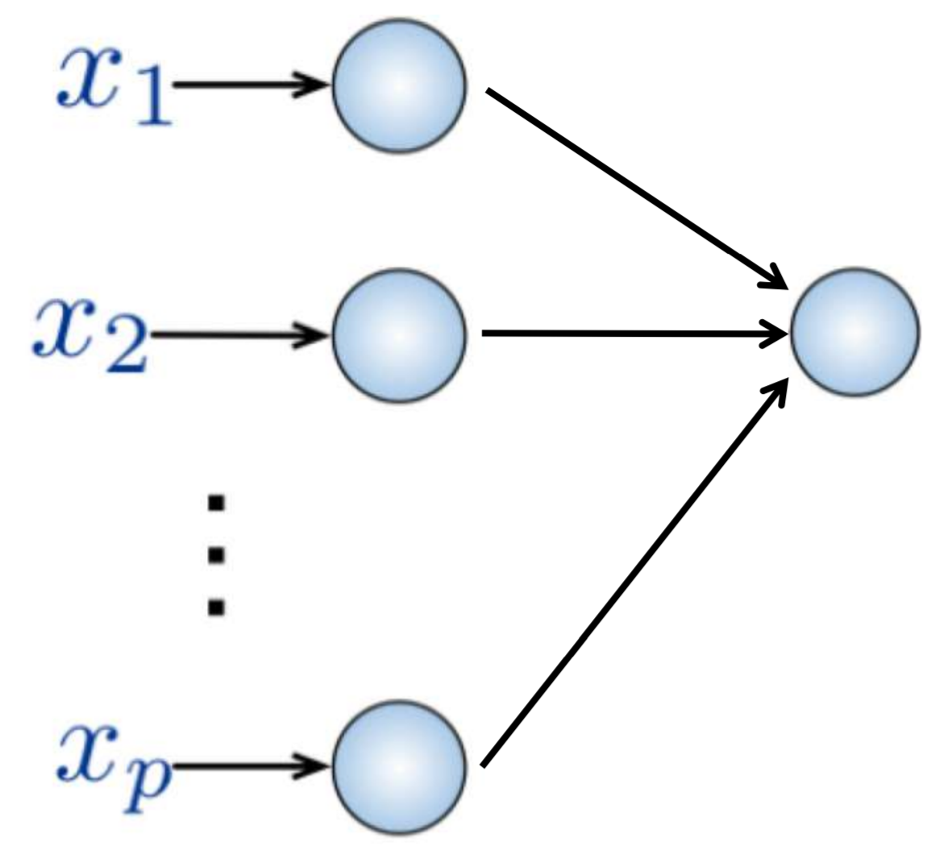
Implementation so far
Use fully connected feed-forward neural network with many layers
Hopefully each layer will learn some important features
And, finally we will be able to represent the correct function
However, no spatial information
Many, Many features
Input
Flattened 1-D vector of image representing numbers
However, important spatial information gone!!!

Slide 9
What can we do?
We need to use the spatial features
How
We can use filters to detect visual features like lines/segments etc.
Do not use fully connected layers for the entire input
Image size could be more than 256X256 nowadays
If we use 1000 neurons for the first hidden layer
We need to learn around 200 million parameters for the first layer
Any bigger than that --- impossible to fit inside a single computer memory
Use an architecture which reduces the images into features
Learn the features first
Then use the features to classify/recognize

Slide 10
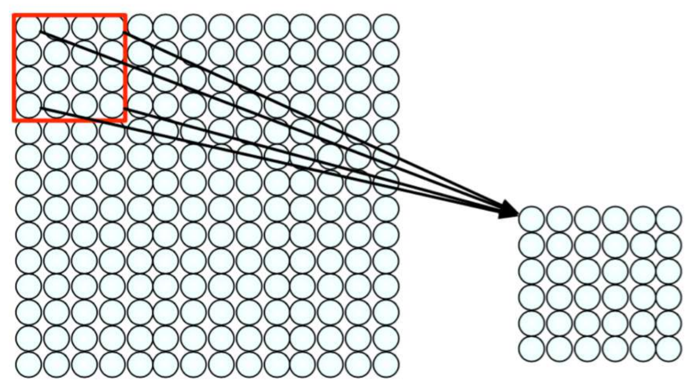
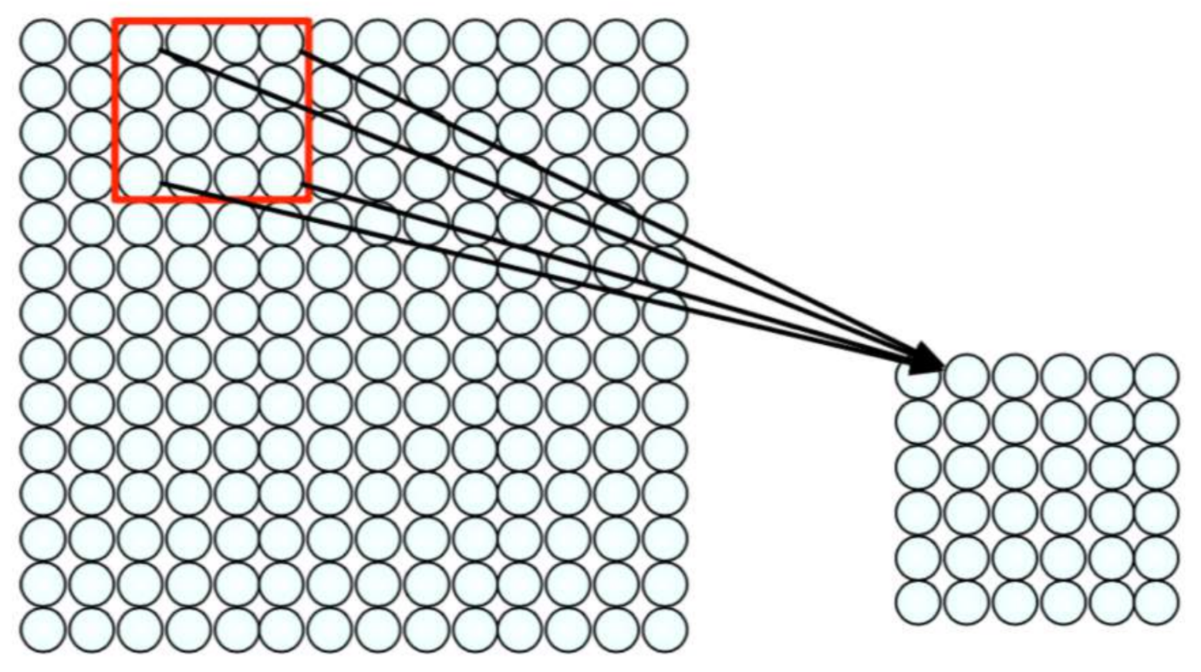
First: Use spatial feature

Slide 11
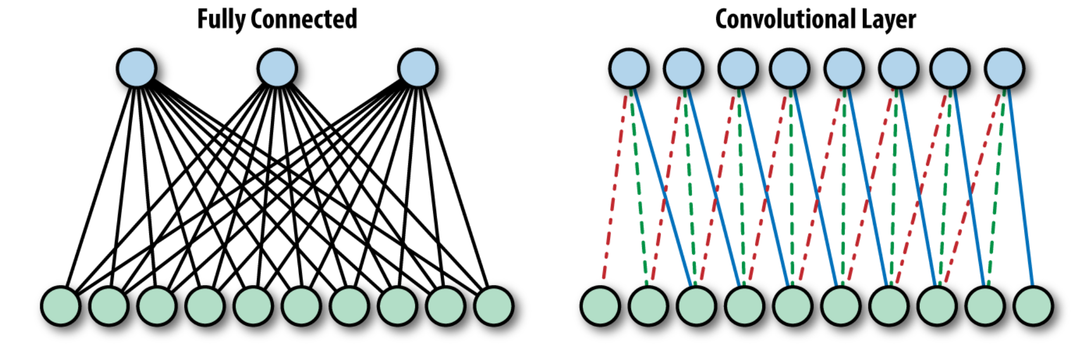
And that gives us – reduced input layer
Now, instead of feeding all input values to all nodes
Feed only portion of image to particular neuron in hidden layers

Slide 12

And a match made in heaven - convolution

Slide 13
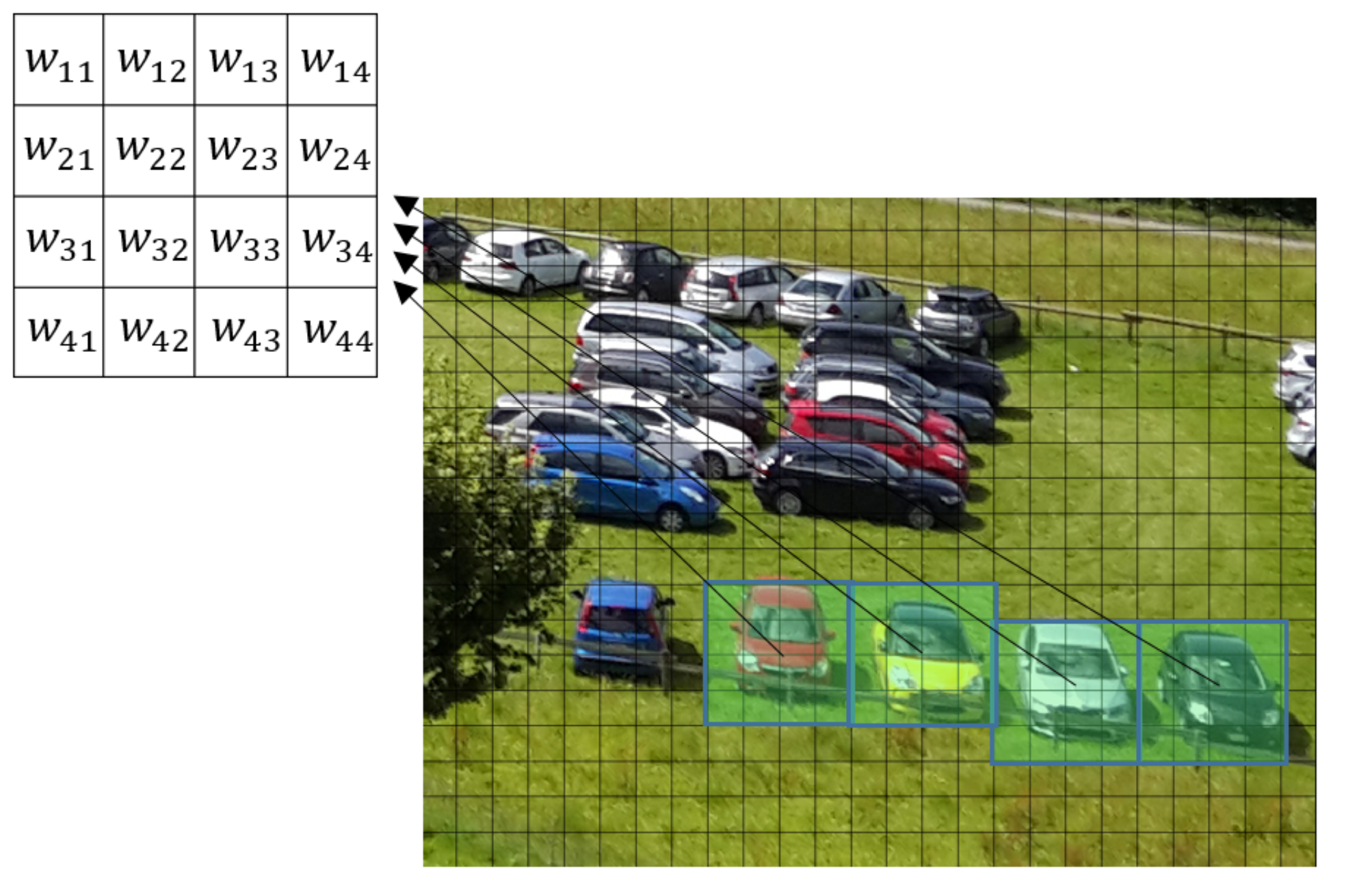
In practice: same filter sliding window algorithm

Slide 14
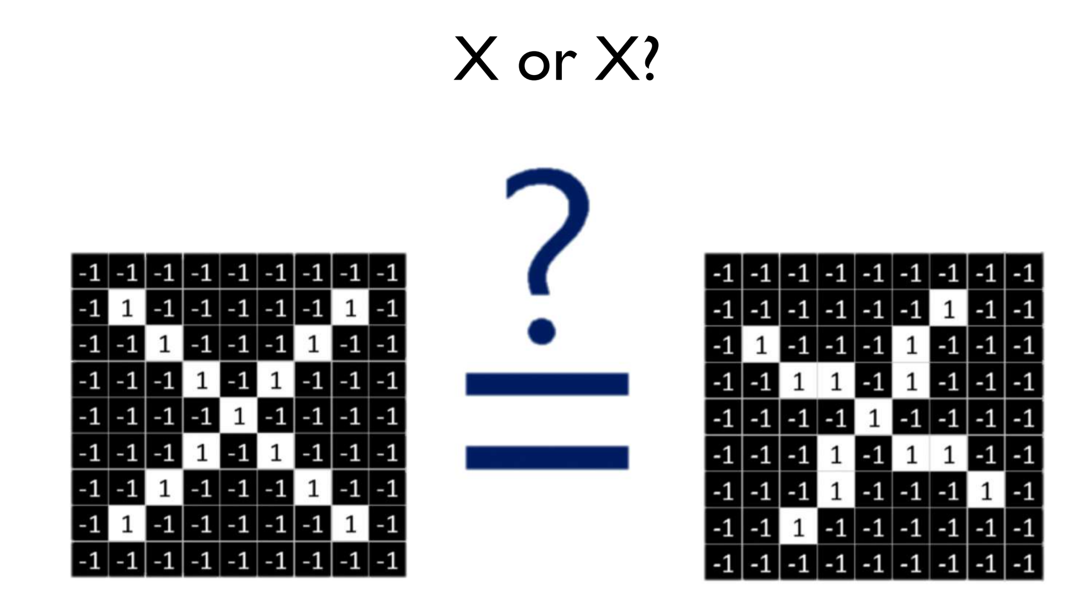
What does it do?

Slide 15
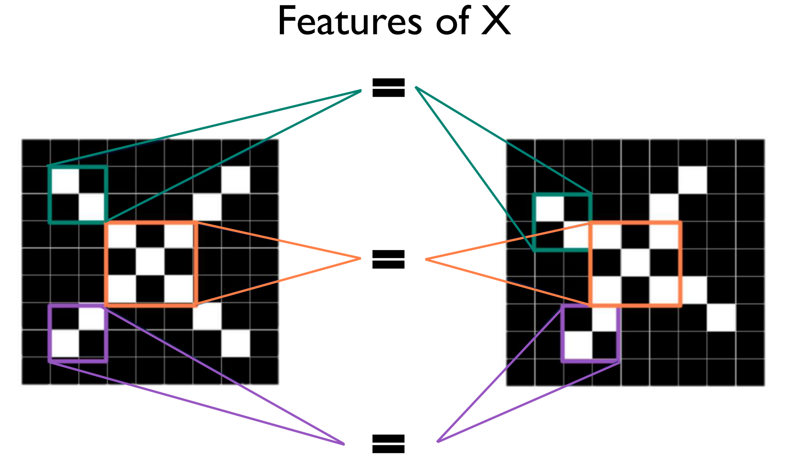
What does it do?

Slide 16
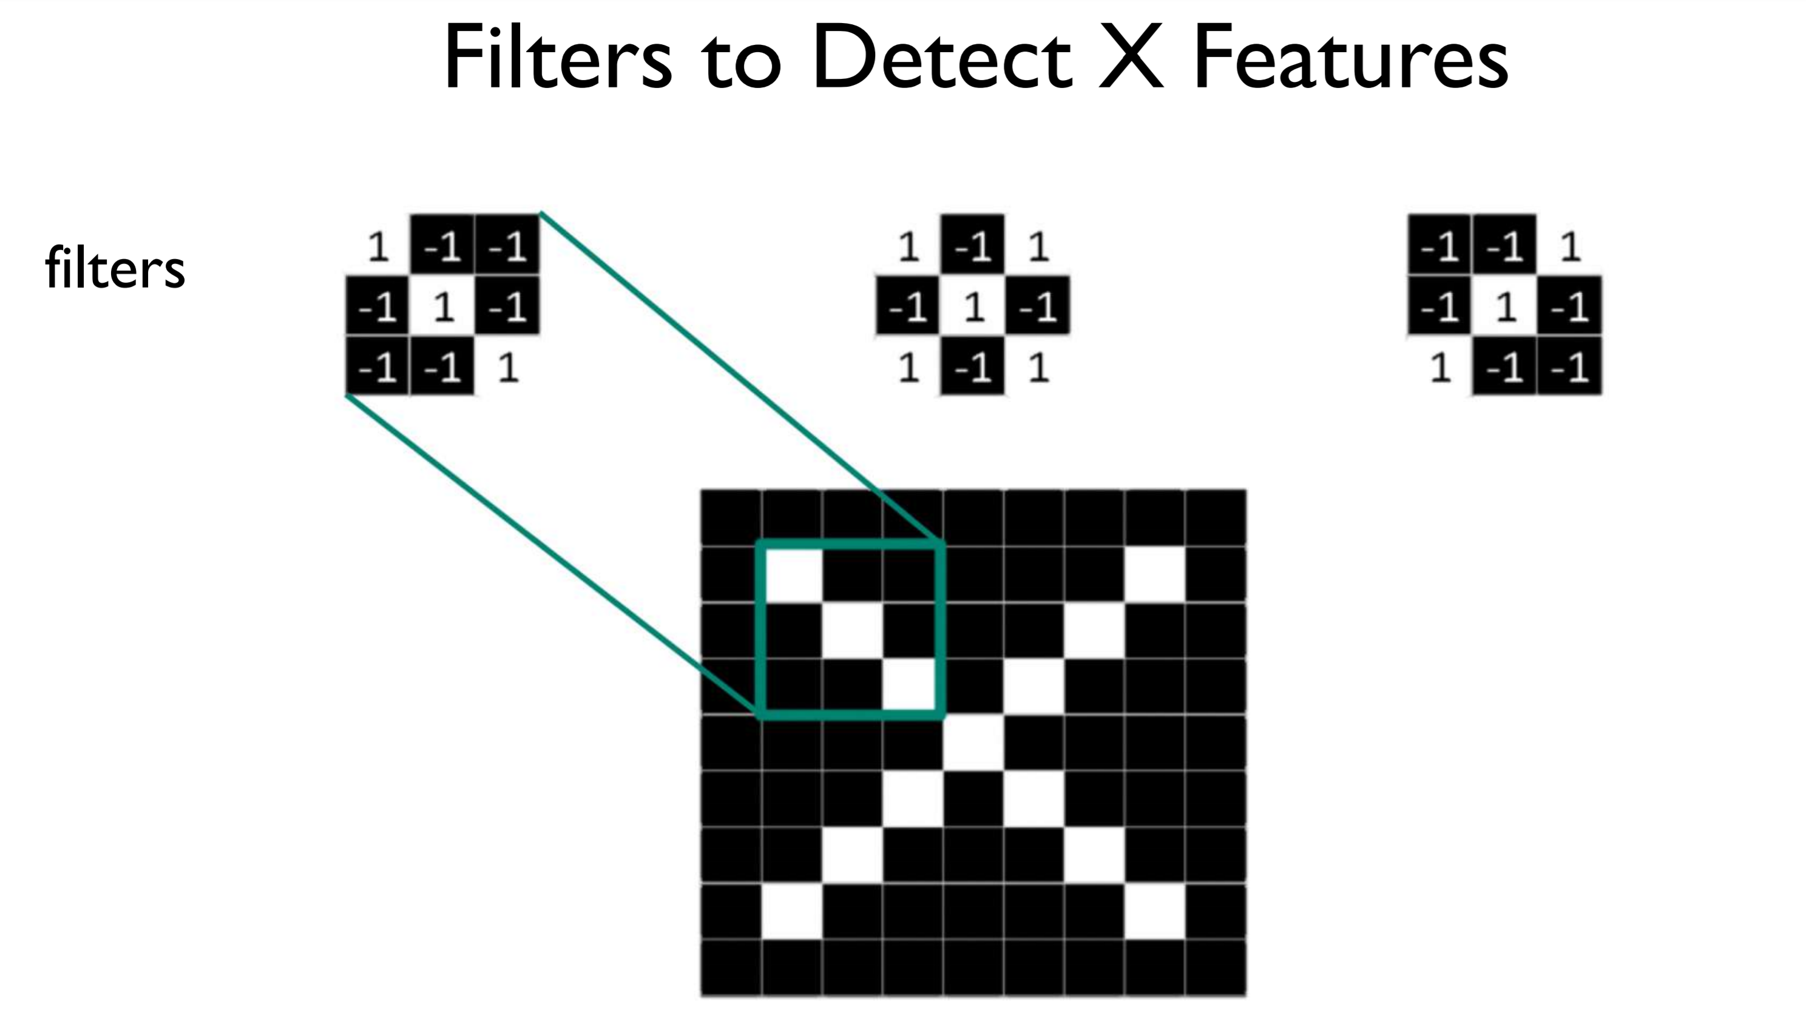
What does it do?

Slide 17
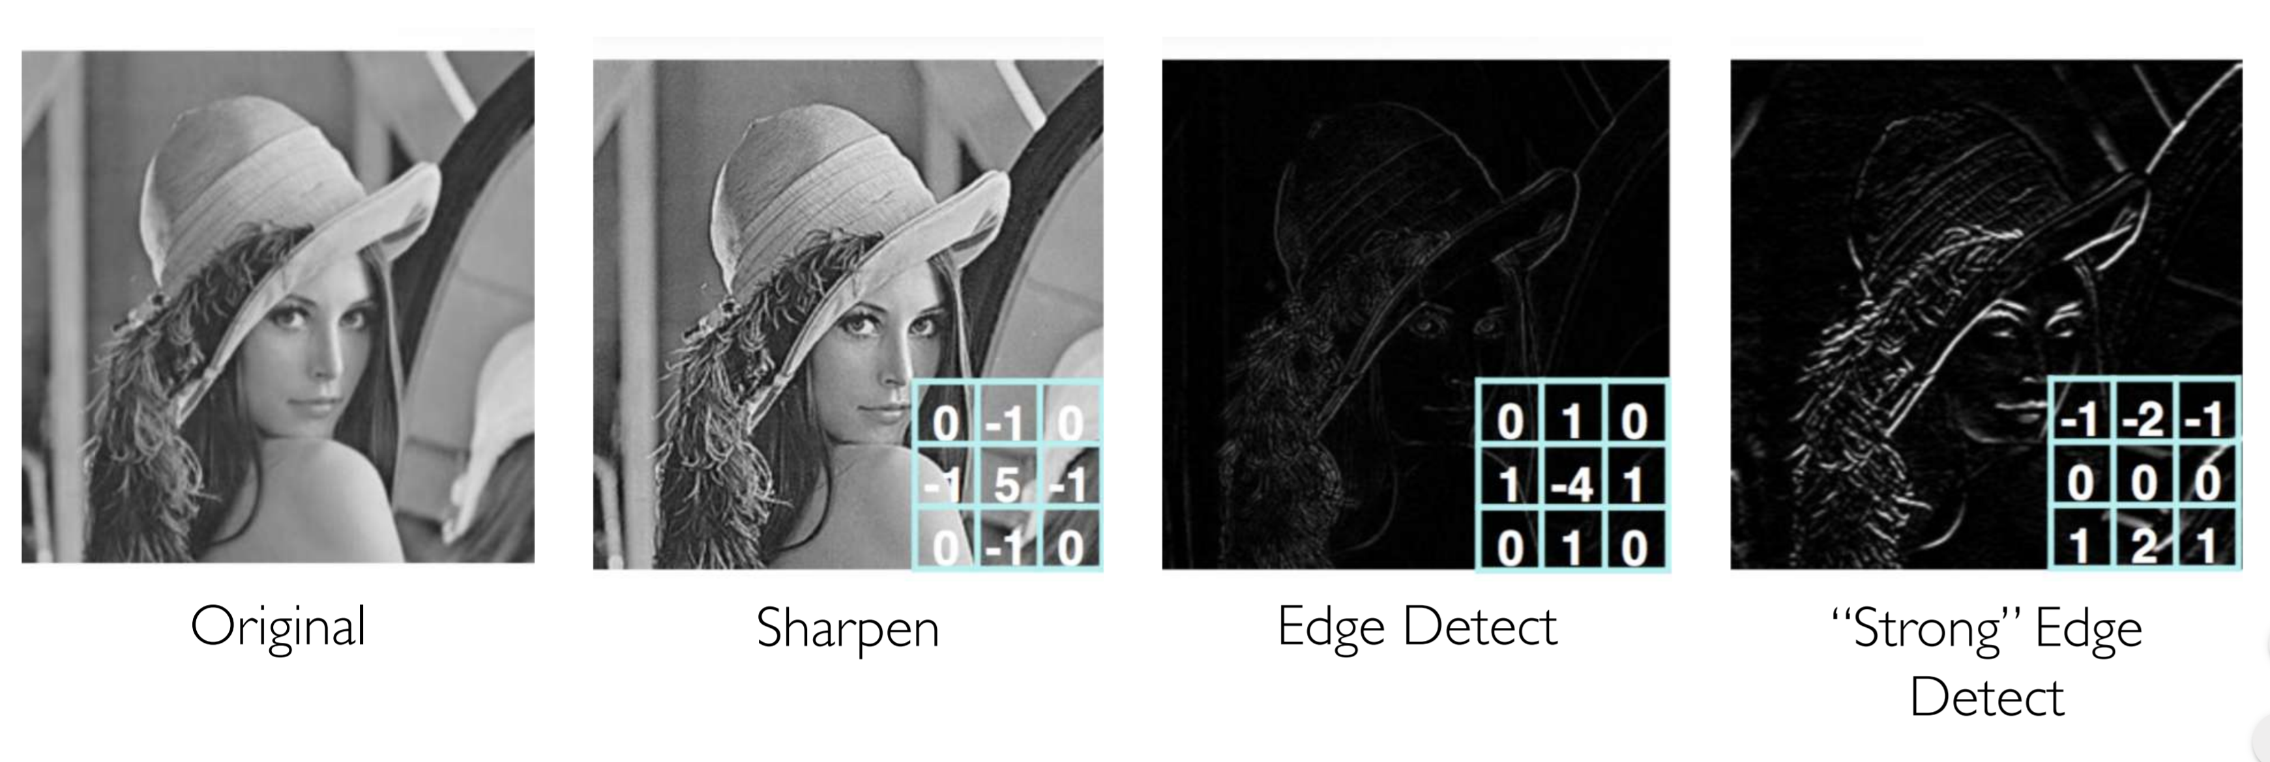
Can we use it to pick features?

Slide 18
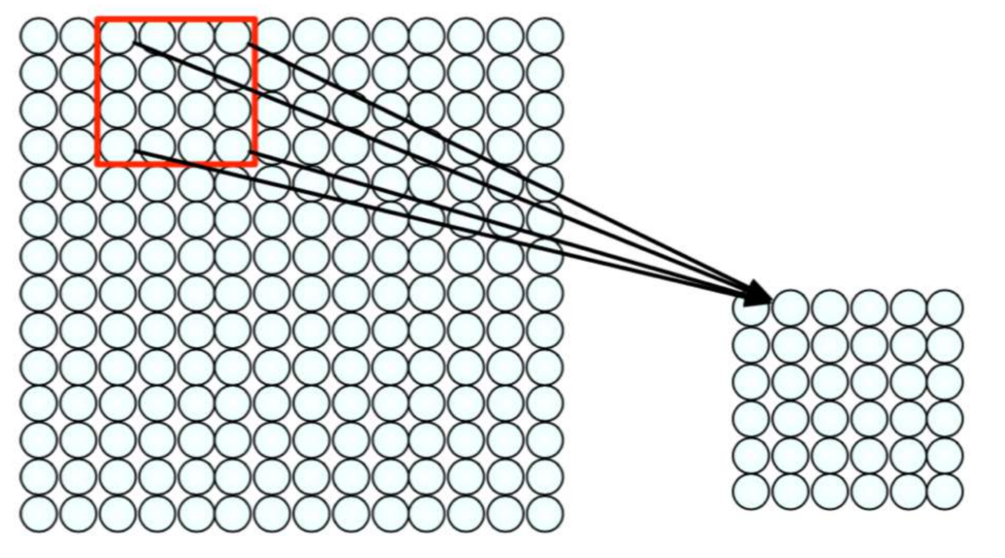
Feature extraction with convolution
Filter of size 4x4 : 16 different weights
Apply this same filter to 4x4 patches in input
Shift by 1/2 (stride) pixels for next patch
Apply a set of weights – a filter – to extract local features
Use multiple filters to extract different features
Spatially share parameters of each filter

Slide 24


Slide 25
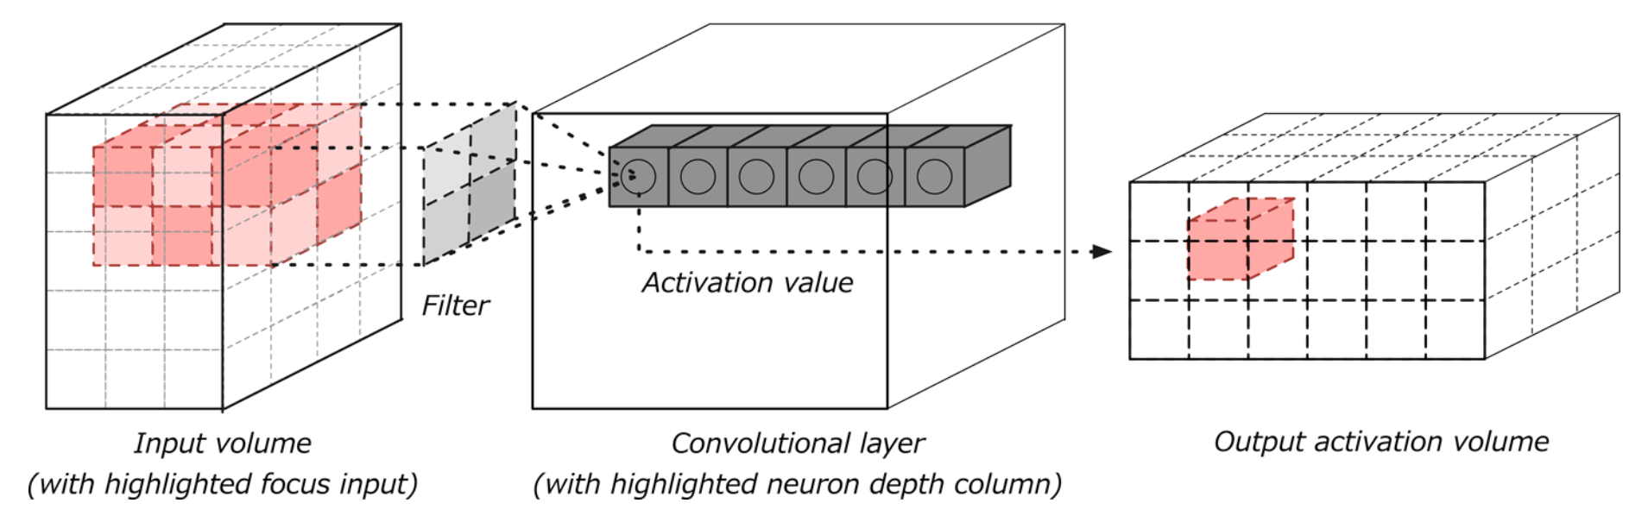
One convolution layer

Slide 29


The whole CNN
cat dog ……
Convolution
Max Pooling
Can repeat many times
Fully Connected Feedforward network
Convolution
Max Pooling
Flattened

Slide 30
Max Pooling
1 | -1 | -1
-1 | 1 | -1
-1 | -1 | 1
-1 | 1 | -1
-1 | 1 | -1
-1 | 1 | -1
Filter 1
Filter 2
3
-1
-3
-1
-1
-1
-1
-1
-3
1
0
-3
-1
-1
-2
1
-3
-3
0
1
-1
-1
-2
1
3
-2
-2
-1
-1
0
-4
3

Slide 31


Why Pooling
Subsampling pixels will not change the object
bird
bird
Subsampling
We can subsample the pixels to make image smaller
fewer parameters to characterize the image

Slide 32
A CNN compresses a fully connected network
Reduces number of connections
Shared weights on the edges
Max pooling further reduces the complexity

Slide 35
Max Pooling
New image
but smaller
1 | 0 | 0 | 0 | 0 | 1
0 | 1 | 0 | 0 | 1 | 0
0 | 0 | 1 | 1 | 0 | 0
1 | 0 | 0 | 0 | 1 | 0
0 | 1 | 0 | 0 | 1 | 0
0 | 0 | 1 | 0 | 1 | 0
Conv
3
0
-1
1
Max
Pooling
3
1
0
3
2 x 2 image
6 x 6 image
Each filter
is a channel

Slide 36
The whole CNN
3
0
-1
1
Convolution
3
1
0
3
Max Pooling
Can repeat many times
A new image
Convolution
Smaller than the original image
The number of channels is the number of filters
Max Pooling

Slide 37
The whole CNN
cat dog ……
Convolution
Max Pooling
Fully Connected Feedforward network
A new image
Convolution
Max Pooling
Flattened
A new image

Slide 38
Flattening
3
0
1
3
0
-1
1
3
3
1
-1
0
3
Flattened
1
Fully Connected Feedforward network
0
3

Slide 39
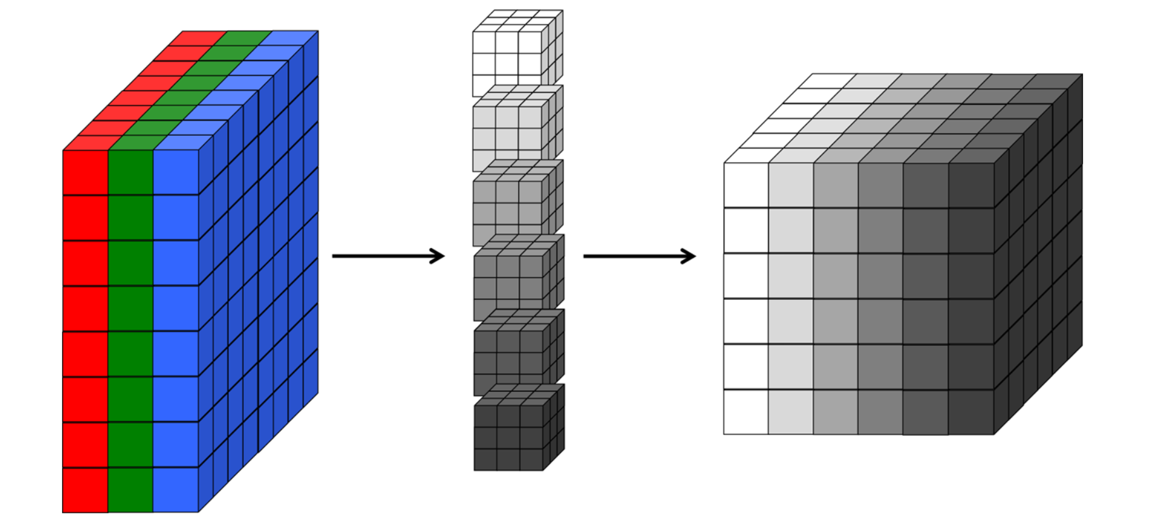
Convolusion representation using volumes

Slide 40
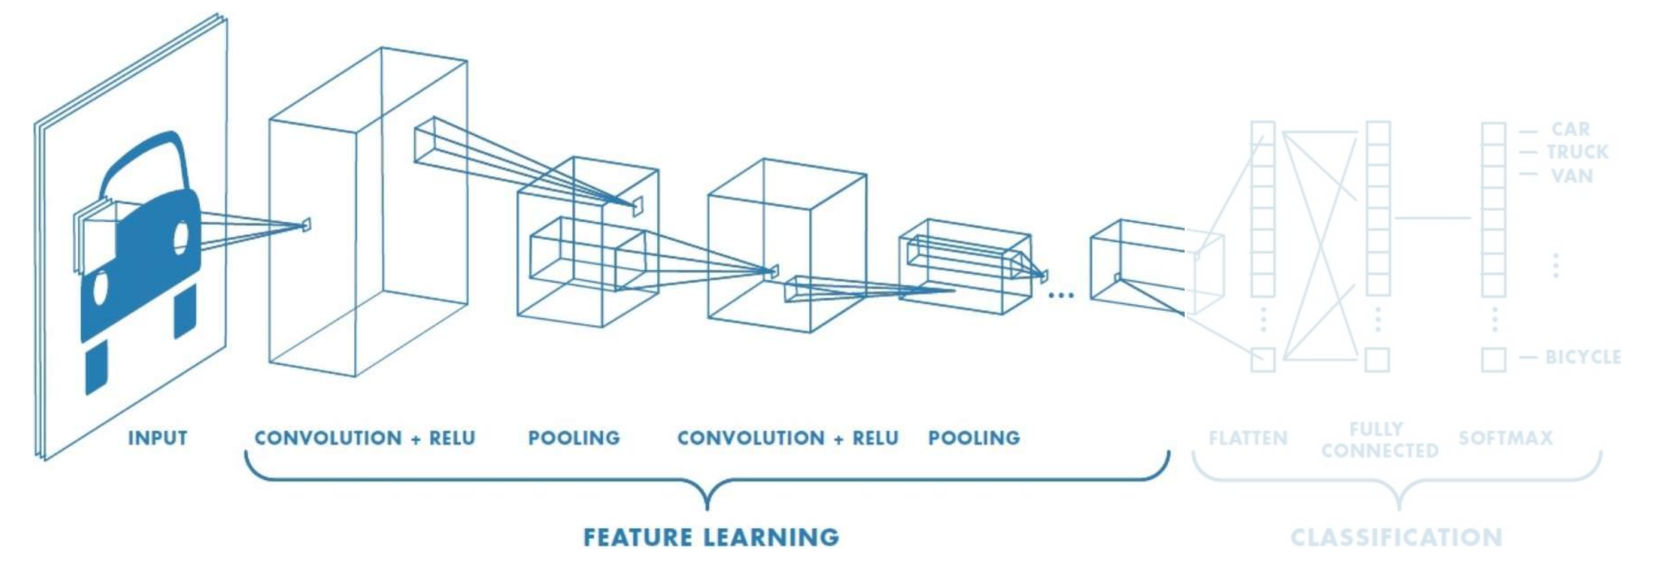
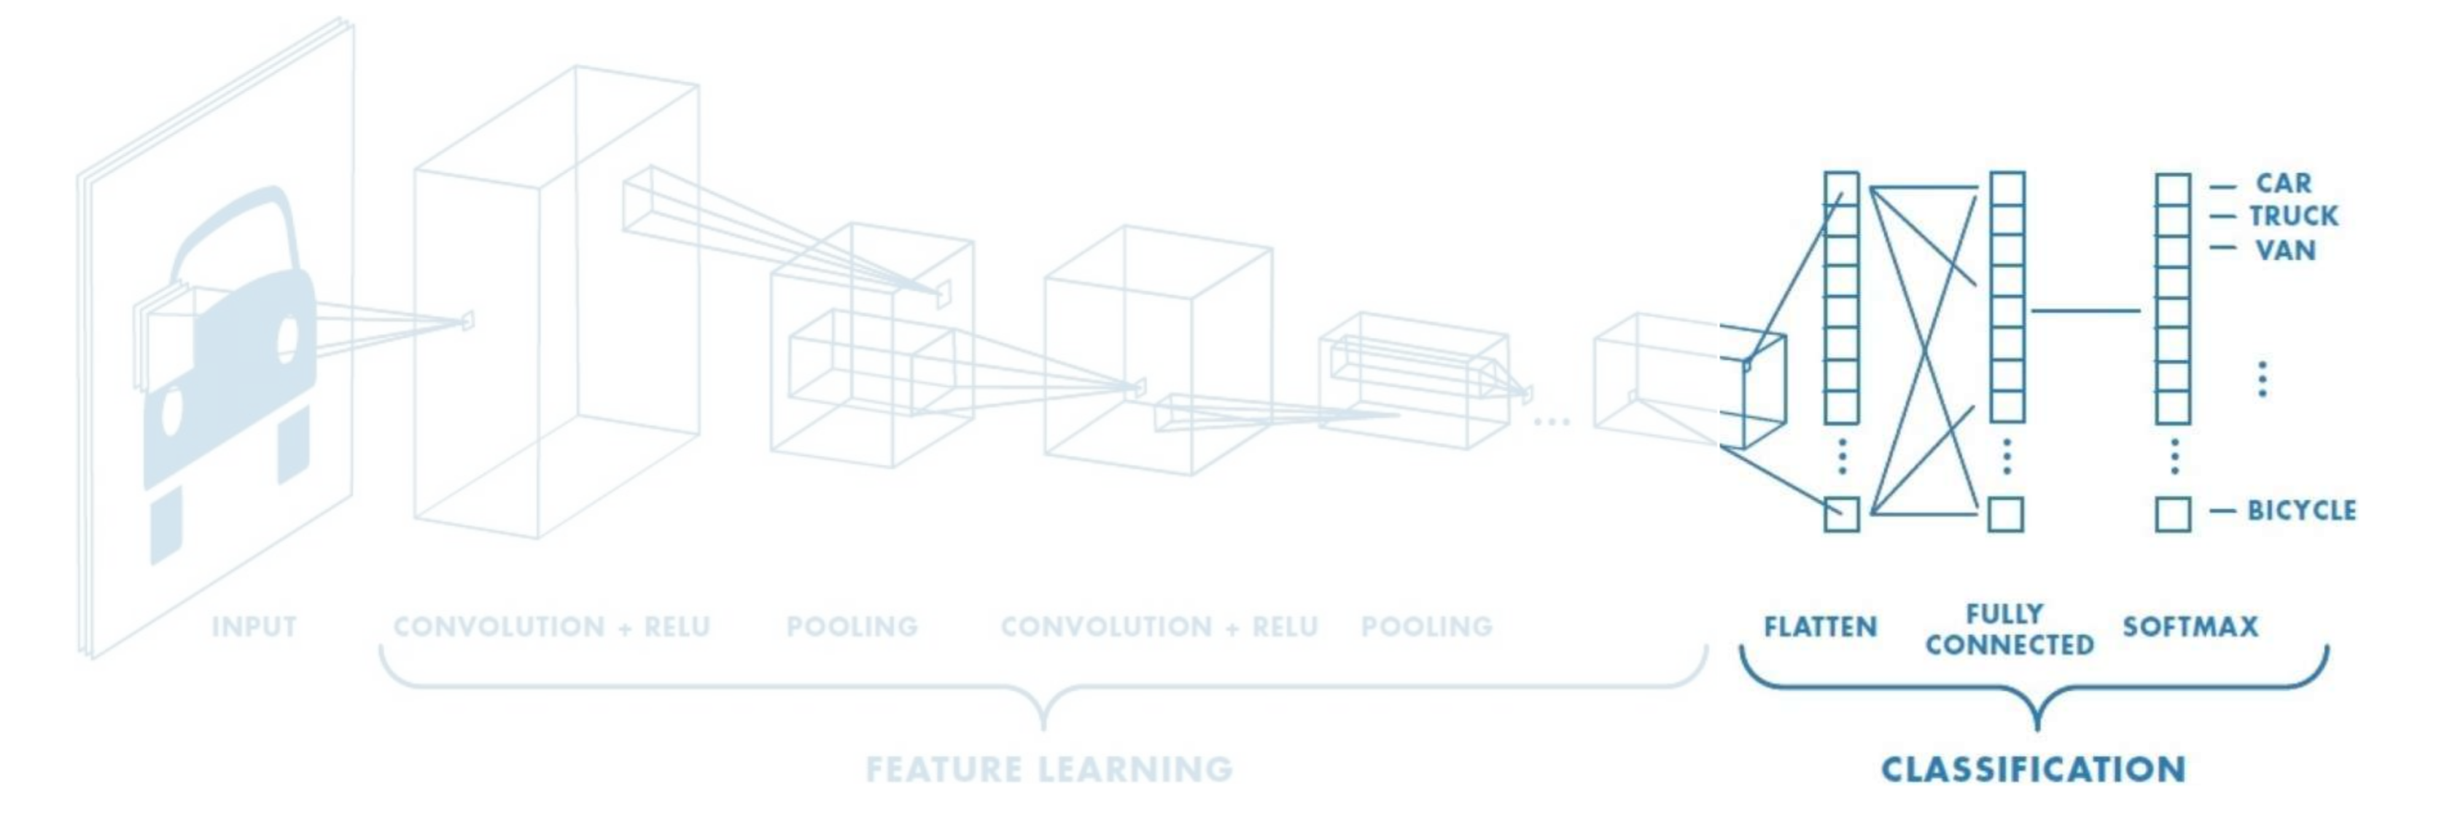
In summary CNN is composed of two networks

Slide 41
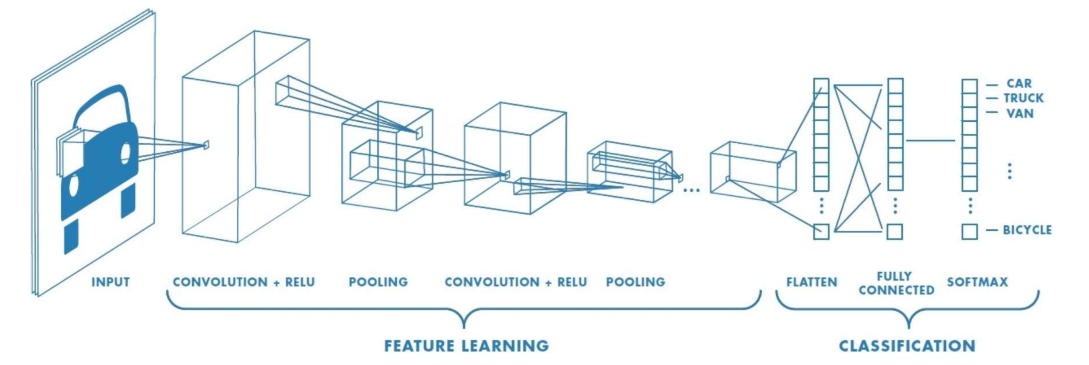
Training CNN
Learn weights for convolutional filters and fully connected layers using backpropagation and the log loss (cross-entropy loss) function

Slide 42
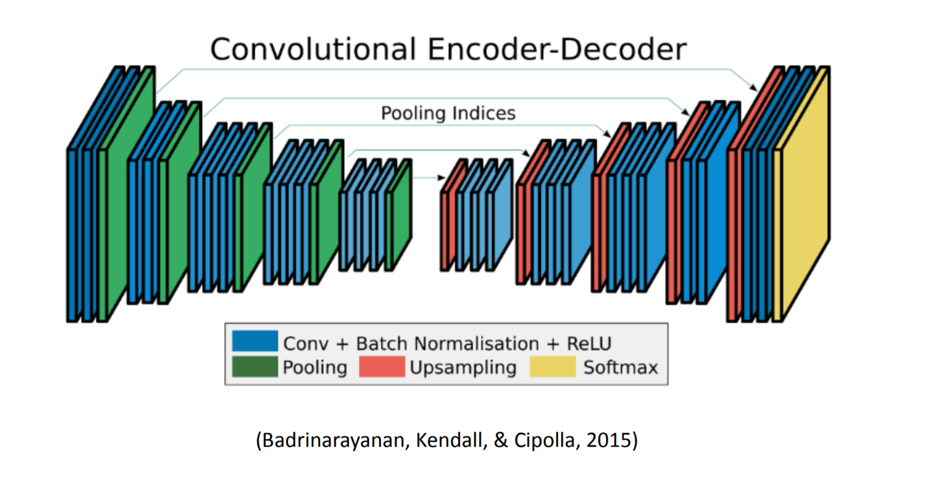
CNN Application: Self driving cars/drones
Convolution then de-convolution
Get a pixel level map

Slide 43
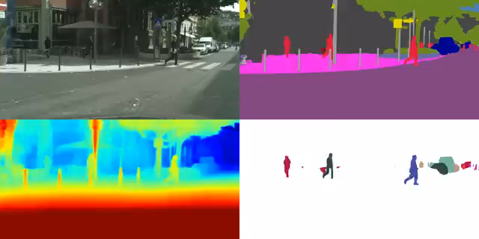
Self driving cars/Drones
Notes:
Multi-Task Learning Using Uncertainty to Weigh Losses for Scene Geometry and Semantics; Alex Kendall, Yarin Gal, Roberto Cipolla

Slide 44
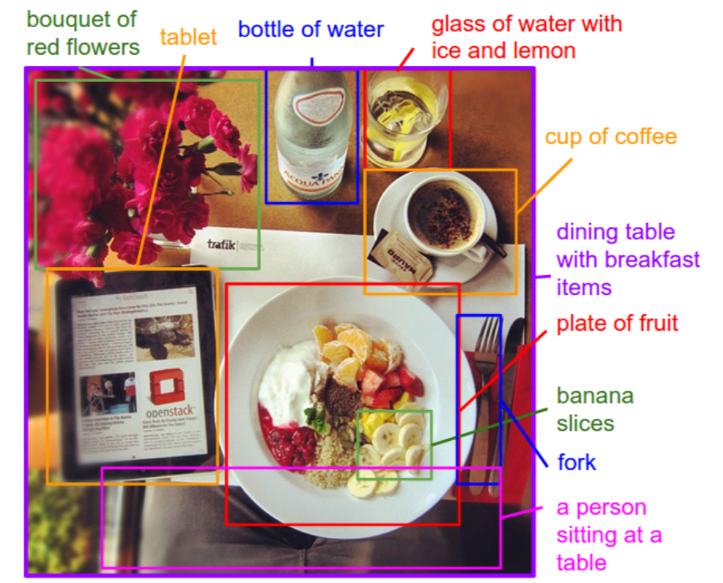
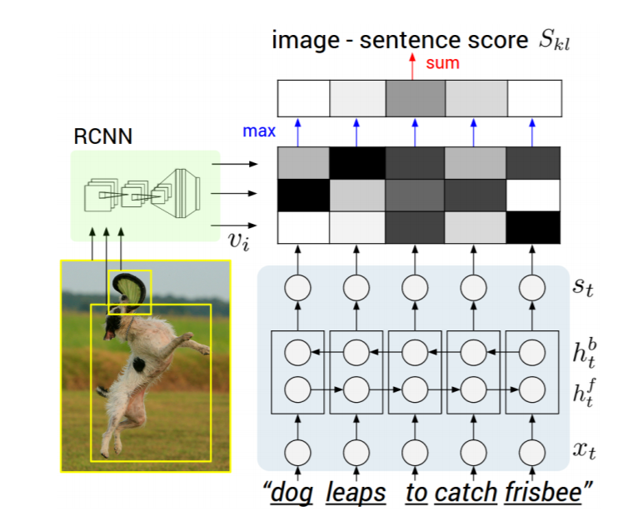
Generate image caption/description
Use CNN to detect the image features
Then instead of using the FCN
Use RCN to generate the description
Notes:
Deep Visual-Semantic Alignments for Generating Image Descriptions; Andrej Karpathy, Li Fei-Fei

